Slide 1
Cluster Setup and Management
Installation and Management
SoftUni Team
Technical Trainers
Software University
https://about.softuni.bg

Slide 2
Have a Question?
sli.do
#Kubernetes
https://www.facebook.com/groups
/KubernetesOctober2021
Notes:
2

Slide 3
Homework Progress
Submit M1 until 23:59:59 on 07.11.2021
Submit M2 until 23:59:59 on 14.11.2021

Slide 4

Previous Module (M1)
Quick overview

Slide 5
Table of Contents
Containerization and Orchestration
Kubernetes Architecture and API
Basic Tools
Basic Objects
5
Notes:
5

Slide 6

This Module (M2)
Notes:
6

Slide 7
Table of Contents
Basic Cluster Installation
Manage and Upgrade Kubernetes Cluster
Highly-available Kubernetes Cluster
7
Notes:
7

Slide 8
Basic Cluster Installation
The semi-hard way
Notes:
8

Slide 9
Architecture Overview *
Kubernetes Cluster
Control Plane Node
Control Plane Node
Node 1
Node 2
Control Plane Node
Pod 1
Pod 1
Proxy
Proxy
Scheduler
Kubelet
Pod n
Kubelet
Pod n
Controller
Node 3
Node 4
API Server
Pod 1
Pod 1
Proxy
Proxy
Persistent Store
Kubelet
Pod n
Kubelet
Pod n
* Not all components are shown

Slide 10
What Will We Install? *
Control Plane
Member Nodes
node-1
node-2
node-3
POD Network
Container runtime
Container runtime
Container runtime
* + other components that will installed both explicitly and implicitly

Slide 11
How Will We Do It?
Prepare a golden image
Create the infrastructure
Initialize the Control Plane
Join the other nodes
Work with our new cluster

Slide 12

Practice
Live Exercise in Class (Lab)
Notes:
12

Slide 13
Manage and Upgrade k8s Cluster
Notes:
13

Slide 14
Node Maintenance
Make the node unavailable for new work (cordon)
Initiate workload migration (drain)
All pods are evicted and recreated on other nodes
Node is ready for maintenance
Declare the node ready for accepting work (uncordon)

Slide 15
Cluster State Backup/Restore
etcd is the default database for storing the cluster state
It runs on the control plane node(s)
Use the etcdctl command to control it

Slide 16
Cluster Upgrade
Control plane nodes (one by one)
kubeadm
Upgrade the node
Drain the node
Upgrade the other components
Uncordon the node
Nodes (one by one)
Same approach as with the control plane nodes

Slide 17
Practice
Live Exercise in Class (Lab)
Notes:
17

Slide 18
Highly-available k8s Cluster
Notes:
18

Slide 19
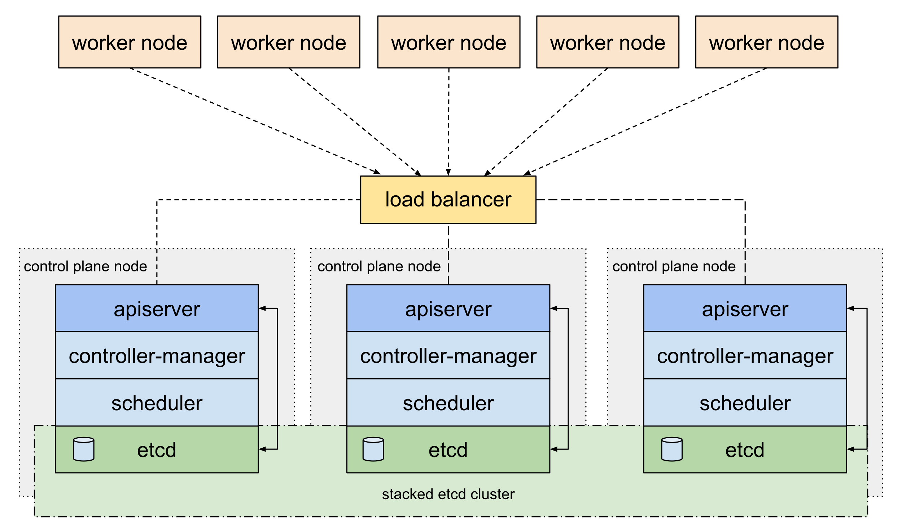
Option 1 (stacked etcd)
https://kubernetes.io/docs/setup/production-environment/tools/kubeadm/ha-topology/#stacked-etcd-topology

Slide 20
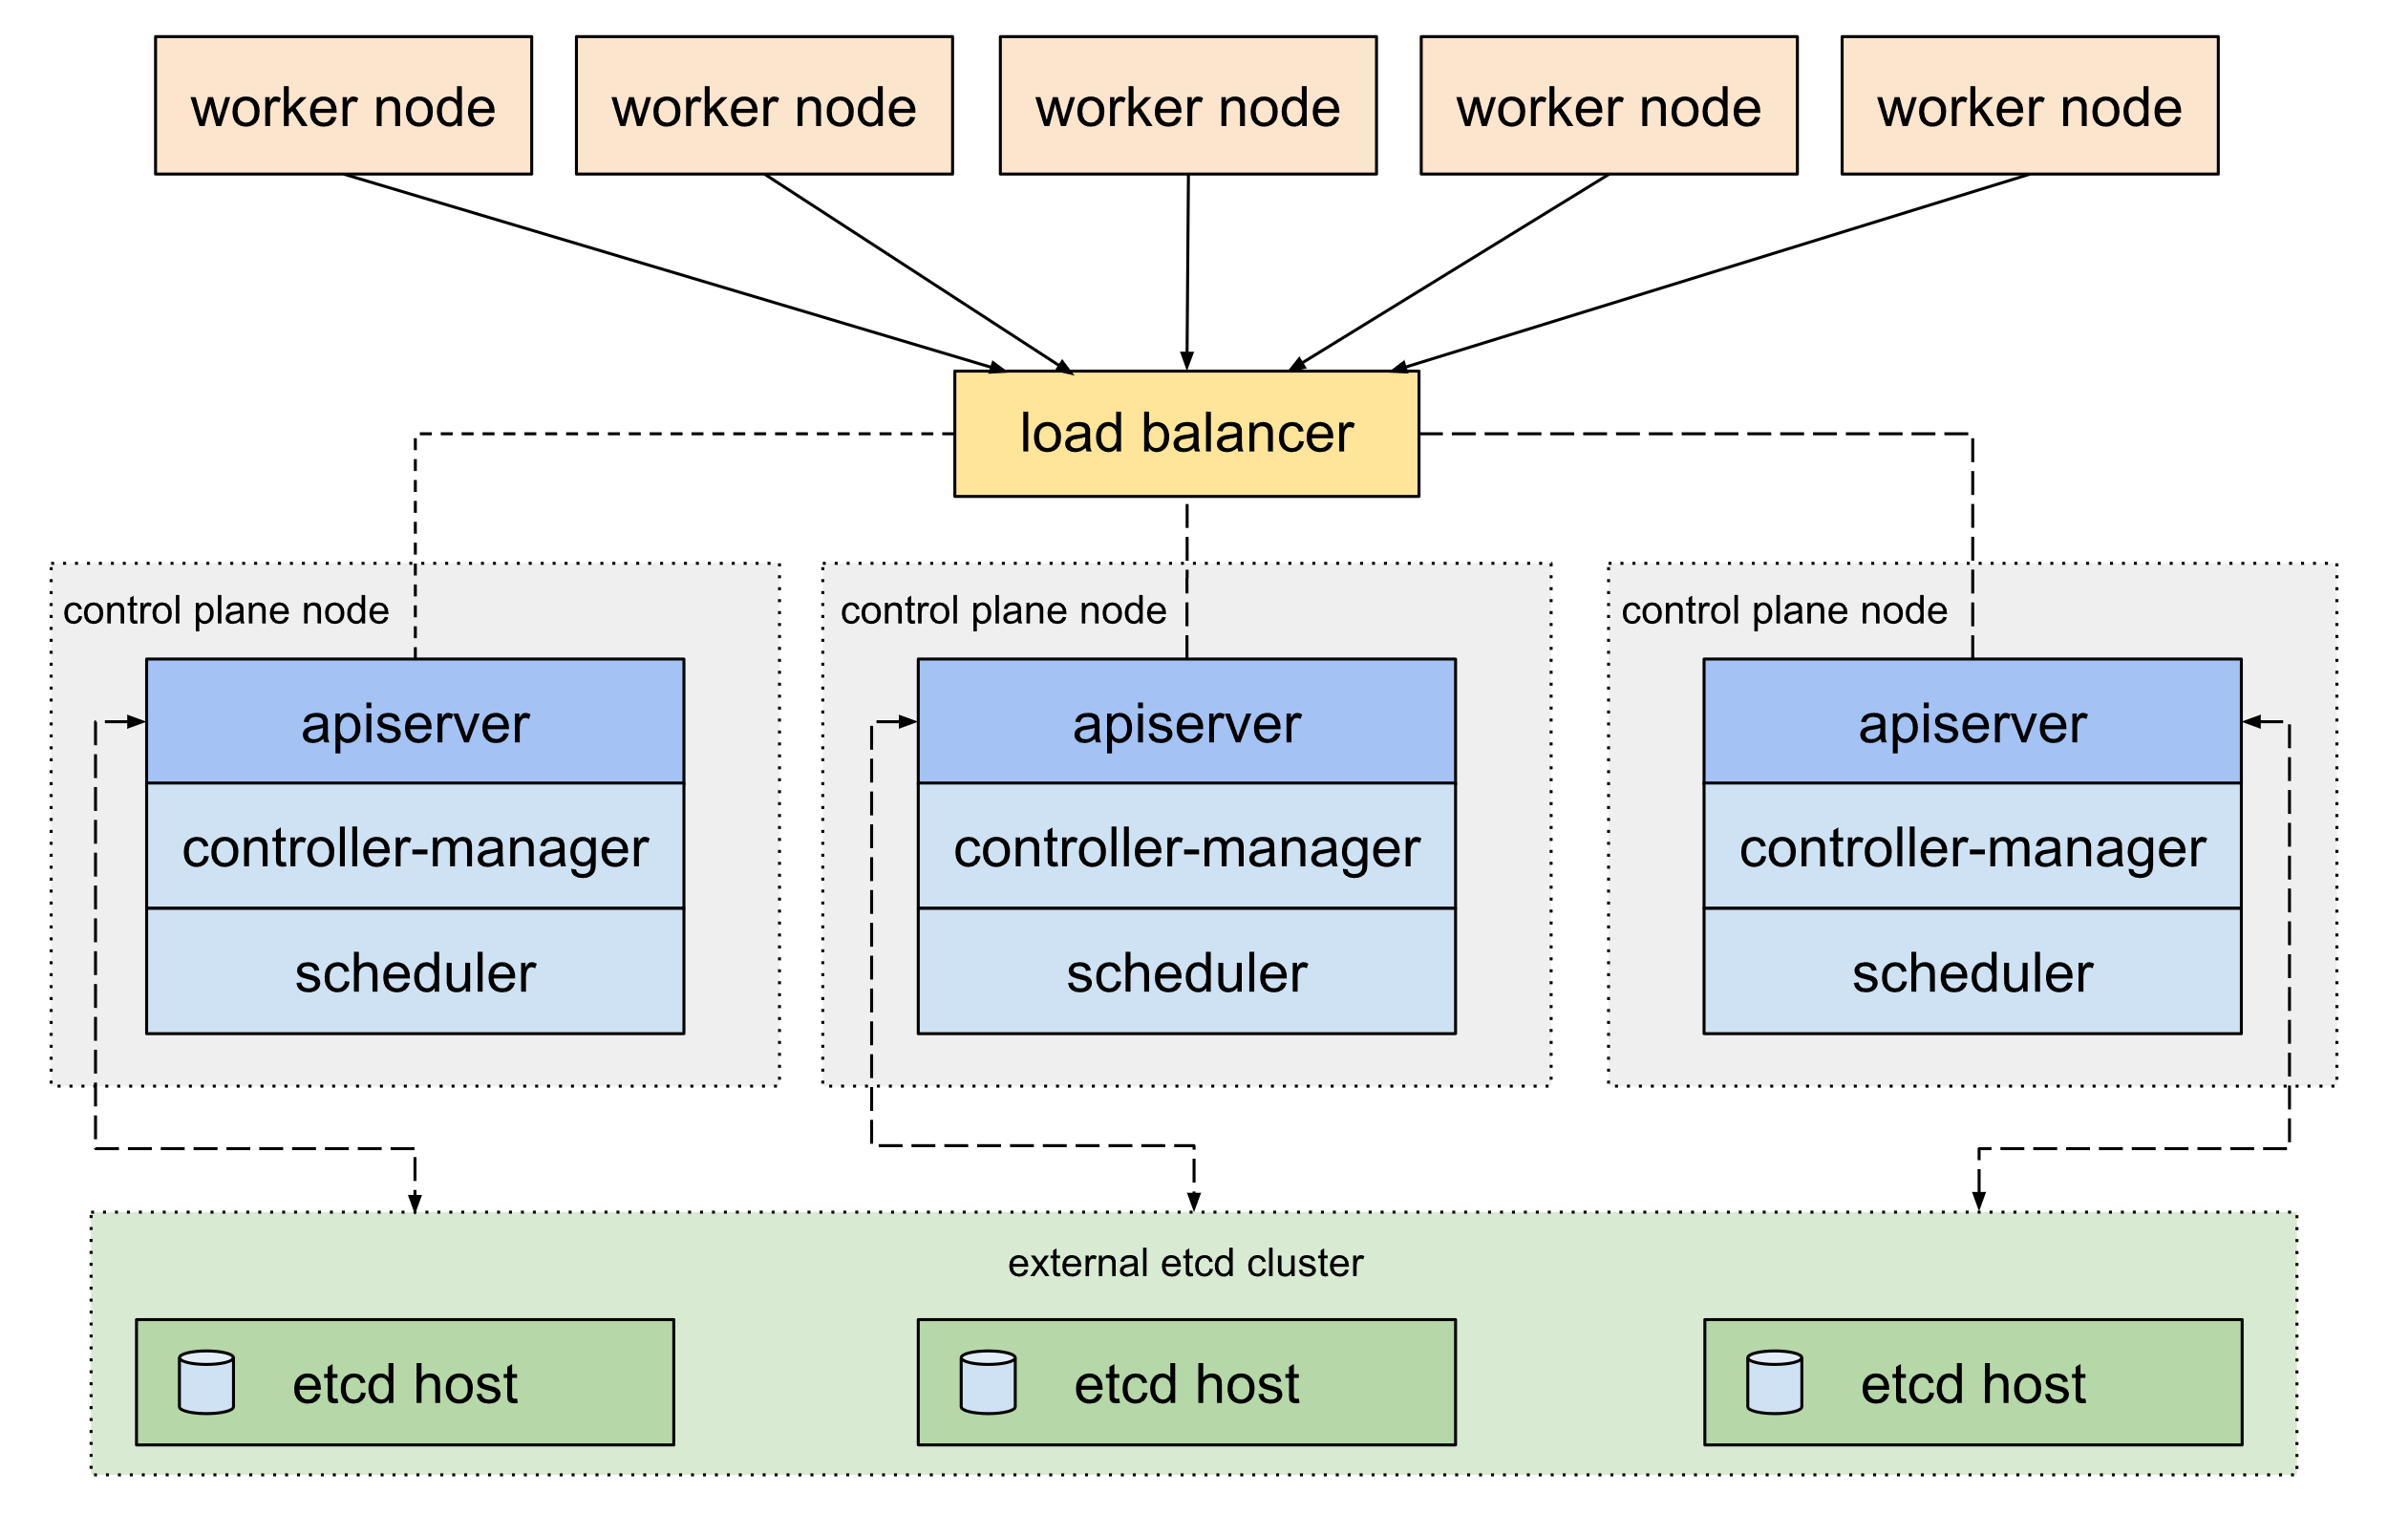
Option 2 (external etcd)
https://kubernetes.io/docs/setup/production-environment/tools/kubeadm/ha-topology/#external-etcd-topology

Slide 21
Practice
Live Exercise in Class (Lab)
Notes:
21

Slide 22
Questions?
Notes:
22

Slide 23










SoftUni Diamond Partners

Slide 24



Educational Partners

Slide 25

License
This course (slides, examples, demos, exercises, homework, documents, videos and other assets) is copyrighted content
Unauthorized copy, reproduction or use is illegal
© SoftUni – https://about.softuni.bg/
© Software University – https://softuni.bg
Notes:
25

Slide 26
Trainings @ Software University (SoftUni)
Software University – High-Quality Education, Profession and Job for Software Developers
softuni.bg, about.softuni.bg
Software University Foundation
softuni.foundation
Software University @ Facebook
facebook.com/SoftwareUniversity
Software University Forums
forum.softuni.bg
Notes:
26

